Slide 1
Tips for Ordering Furniture
Information covering contracts:
505ENT-M15-BSI OFFURN-01 Office Furniture (BSI)
505ENT-M15-OFFURNITUR-00 Office Furniture
505ENT-M16-WSCAEDUFURN-00 Educational Furniture
Revised: November 14, 2017

Slide 2
Introduction
The procurement of furniture can be a confusing and complex process.
There are three mandatory contracts:
Contract Number | Description
505ENT-M15-BSI OFFURN-01 | Statewide Office Furniture (BSI)
505ENT-M15-OFFURNITURE-00 | Statewide Office Furniture
505ENT-M16-WSCAEDUFURN-00 | Statewide Educational Furniture
The following slides will provide you with a systematic approach to follow to ensure that you are compliant with State procurement polices and that you obtain the best value for the State.

Slide 3
Definition of Office Furniture
What the contracts cover
Both Office Furniture contracts cover the categories below: | In addition to the categories on the left, the BSI contract covers the categories below:
Systems Furniture and Accessories: Systems, furniture, including monolithic and frame and tile, is a general term for panels, work surfaces, shelves and other items sold by a single manufacturer as a package for furnishing offices. Cubicles and open work environments are the items most often associated with systems furniture, but other open plan arrangements such as office landscape are included. Seating: The seating category includes executive, task/ergonomic, guest/side, reception/lounge, conference room, stackable/foldable, stools. Desks/Tables: A desk/table is a freestanding unit having a work surface that is supported by legs or pedestals. In some instances, the unit will have drawers, doors or other storage elements. Free standing desks, adjustable tables, conference room tables, small office tables, side tables and dining tables are included in this category. Filing, Metal Storage, and Wood Case-Goods: The filing, metal storage and wood case-goods category includes but is not limited to: bookcases, wardrobes, cabinets, free standing and mobile pedestals and wall mounted shelving. This category does not include shelving units that are attached to system furniture cubicle walls. Design Services: Design Services include but are not limited to; space planning, installation plans, furniture migration strategies, reconfiguration of existing systems, assistance with furniture selection, interior office design and computerized installation drawings. Installation Services: Installation Services include all labor required to disassemble, assemble, deliver, set-up, install and otherwise finish an office installation or remodel project. | Institutional Furniture: Furniture for institutional markets designed primarily for the correctional setting and can be manufactured from wood, steel and stainless steel. This category includes cell and dormitory furniture, desks, stands, lockers, seating, tables, dining room tables, kitchen and laundry carts, as well as custom product built to customer specifications. Computer Furniture and Accessories: Specialty computer workstations. Interface Study Carrel (IFSC), Mobile Study Workstation (MWS), Mobile Computer Stand (MCW), workstation storage units, box/file drawer, hang-on pedestal file, pencil drawer. Computer accessories, such as, articulating keyboard holders, Swing-Arm Monitor Lifts for CRT and flat screens, portable laptop station, document holders, turntable, wrist wrests, mouse pads, pop-up electrical outlets, lights for hutches, grommets for wire management, paper management features and accessories and casters. Custom Made Desks, Credenzas, and Matching Bookshelves (Metal and Wood): Custom made office suite furniture, including executive desks, secretarial desks, credenzas and bookshelves

Slide 4
Definition of Educational Furniture
What the contracts cover
The Educational Furniture contract is designed to fill a gap in products not found on the Office Furniture contracts, products typically found in an educational environment.
General Education Furniture Desks: Combo desks, multi-student, open front, ADA, study carrels and teacher workstations. Desks shall be durable with a variety of base/leg, finishes, shapes and size options. Tables: Activity tables, art tales, ceramic, collaborative tables, computer tables, demonstration, drafting tables, flip-top tables, folding tables, science tables, sewing, training tables, height adjustable, wood media (library) tables, and table dollies. Tables shall be durable and be available in a variety of base/leg, finishes and size options. Seating: Folding, stacking, nesting, task, stools and chair dollies for K-12 and higher education. Durable with a variety of fabric, finishes, leg, caster, back and seat options. Lounge Seating and Tables: Tables and seating designed to accommodate student’s social activities as well as academic work and utilization of technology (laptops, smartphones, tablets and other electronic devices) and teacher lounge seating. Filing, Storage and Accessories Storage and Accessories: Trophy and display cases, caddies, shelving (laminate, wood, metal), bookcases (wood, metal, laminate), chemical/flammable storage, blueprint storage, music/instrument storage, mobile cabinets and cabinets with locks. Carts: Storage, lecterns, podiums, utility, platform, AV, flat panel, presentation, music/folio, science, syncing/charging, laptop, antimicrobial, specialty (geology/microscopes), mobile lab units, music storage/instruments. Lockers and Accessories: Metal, plastic, and wood lockers and storage cubby’s for school. Gym and classroom storage in a variety of sizes and styles. Accessories include locker room benches. | Residential Furniture and Accessories Student (Residential) Housing: Bedding, desks, tables, seating, and storage that is durable, adjustable and available in a variety of styles, finishes and fabrics. Accessories may include but are not limited to lighting. Outdoor Furniture Picnic tables, seating, benches. Accessories may include, but are not limited to trash receptacles, and bike racks in durable weather resistant materials. Stages and Risers Portable stages, risers and accessories. Choral risers, seated band, transport risers, adjustable and fixed height stages available in a variety of sizes, shapes and finishes. Accessories may include, but are not limited to, transportation carts, stairs, ADA ramps, guard rails, skirting, backdrops, wall padding, chair stops, crowd control banners, and player tunnels. Cafeteria Tables and Seating and Accessories Cafeteria tables and seating that are durable, stain resistant and available is a variety of sizes, styles, finishes and options. With and without attached seating, wall mounted, freestanding, café, bistro, barstool, booths and fixed seating. Accessories may include, but not limited to trash receptacles, tray stands and recycle bins. Lecture Hall and Auditorium Seating and Accessories Seating and tables designed tor lecture hall including fixed and stand-alone tables and fixed and stand-alone seating. Auditorium seating that is available in a variety of configurations and options. Accessories may include, but are not limited to aisle lights, cup holders, tablet/computer arms and power and data connections.

Slide 5
What the contracts DO NOT cover
Contracts DO NOT include:
  Used or refurbished furniture of any kind
  Laboratory furniture
    Some science room furniture IS included on the Educational Furniture contract

Slide 6
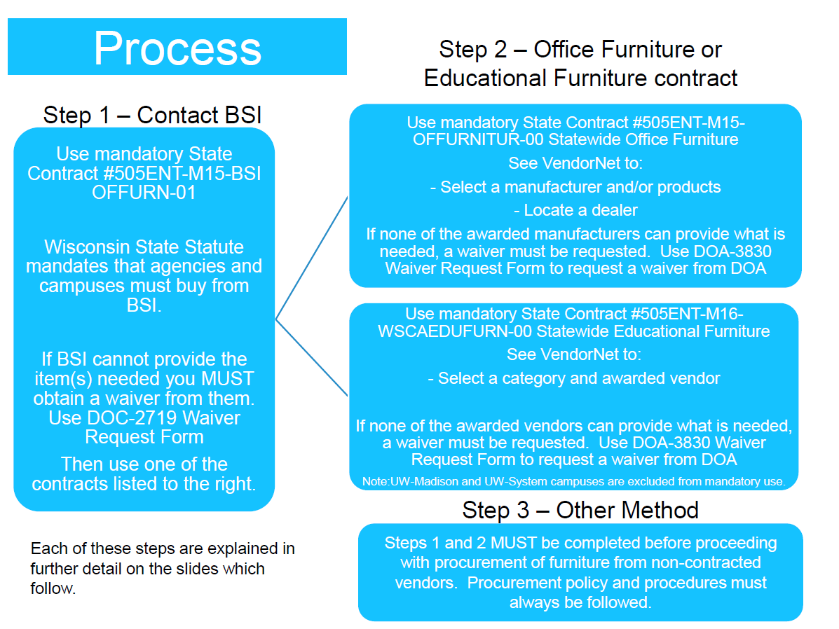

Slide 7
BSI Mandatory Furniture Contract
Contract 505ENT-M15-BSIOFFURN-01
Wisconsin State Statute 16.75(3t)(c) defines state agency requirements to purchase from prison industries when Badger State Industries (BSI) is able to meet product specifications and price on products which they offer. When using mandatory contract 505ENT-M15-BSIOFFURN-01 for the purchase of office furniture, each Agency/Campus must first contact BSI to meet their needs. If BSI determines that they cannot meet the Agency/Campus furniture needs then BSI will issue the requesting Agency/Campus a waiver to purchase some or all of the project from another vendor.

Slide 8
BSI Mandatory Furniture Contract
Waiver Process
If it is determined that BSI cannot meet contract defined specifications, match the price or any other reason as accepted by BSI, the Agency/Campus must complete DOC-2719 MANDATORY WAIVER REQUEST FOR OFFICE FURNITURE and e-mail it to BSIFurnitureWaiverRequest@wisconsin.gov.
BSI will send the updated request form back to the Agency/Campus within 2 business days from the time of receipt.
After waiver is received Agency/Campus must utilize one of the other mandatory Statewide furniture contracts.
All Agencies and Campus’s must involve BSI up front in their planning process.
STAR information – Use 0000018858 (Supplier Name Corrections, Dept of aka Short Name CORRECTION-004) and the Supplier Location SUFFIX-AZ when placing orders.
NOTE: Failure to provide adequate lead-time to BSI does NOT justify a waiver request.

Slide 9
Mandatory State Contract
Contract Number: 505ENT-M15-OFFURNITUR-00
General Information
The contract is awarded to multiple manufacturers and each manufacture has their own contract number. The last two digits of the contract designate the vendor.
The award was made by categories and manufacturers can only sell products in the categories which were awarded to them.
Each manufacturer has the ability to assign up to 10 dealers.

Slide 10
Mandatory State Contract
Contract 505ENT-M15-OFFURNITUR-00
Waiver Process
A waiver is required when an Agency/Campus is unable to obtain furniture from BSI and any of the awarded vendors on Contract 505ENT-M15-OFFURNITUR-00. The agency shall not purchase the product until a waiver release number is given by the DOA Contract Manager.
Expect a 3 business day turnaround for waiver requests unless notified otherwise.
Agency/Campus must keep documentation on file that justifies all waivers.
Agency/Campus must request a waiver from DOA before purchasing furniture from a non-contracted vendor.

Slide 11
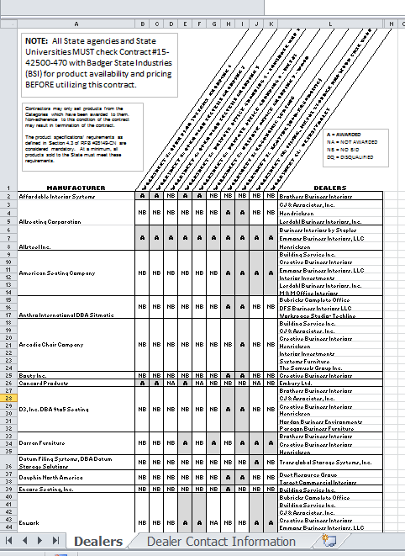
Mandatory State Contract
Contract Number: 505ENT-M15-OFFURNITUR-00
Find a Manufacturer and Dealer
From the Contract screen on VendorNet scroll down to the Attachments section and open the AUTHORIZED DEALERS document.
This document contains two spreadsheets (tabs).
Tab 1 | DEALERS | This spreadsheet shows the association of manufacturer to dealer
Tab 2 | DEALER CONTACT INFORMATION | This spreadsheet has dealer contact information. It is listed by manufacturer.

Slide 12
Mandatory State Contract
Contract Number: 505ENT-M15-OFFURNITUR-00
Review Discounts and Value Add Capabilities
Many manufacturers have offered the State additional discounts, i.e., volume, delivery only and/or value add capabilities. Every buying decision should take into account these additional discounts.
From the Contract screen on VendorNet scroll down to the Attachments and open the PRICING/DISCOUNT INFORMATION document. This document has four worksheets (tabs).
Tab 1 | PRIMARY PRODUCT LINES | This tab will show you the primary product lines, catalogs and discount from list price
Tab 2 | DELIVERY ONLY DISCOUNT | This tab will show you the delivery-only discount you will receive in addition to the primary discount if you choose delivery only to your dock.
Tab 3 | VOLUME DISCOUNTS | This tab will show you, by product line, the volume discounts available on the contract. This only applies to Ergonomic Seating, Non-ergonomic Seating, Filing, Metal Storage and Wood Case Goods and Desks/Tables.
Tab 4 | ADDITIONAL PRICING INCENTIVES | If a manufacturer has offered additional pricing incentives/value add it will be noted on this worksheet.

Slide 13
Mandatory Statewide Educational Furniture Contract
Contract Number: 505ENT-M16-WSCAEDUFURN-00
General Information
This contract is a Participating Addendum to a WSCA-NASPO contract.
The contract is awarded to 9 vendors and each vendor has their own contract number. The last two digits of the contract designate the vendor.
The award was made by category and contractors may only sell products in the categories which were awarded to them.

Slide 14
Mandatory Statewide Educational Furniture Contract
Contract Number: 505ENT-M16-WSCAEDUFURN-00
Waiver Process
This contract is mandatory for State agencies ONLY. UW-Madison and UW-System campuses are excluded from mandatory use of this contract and are directed to use the appropriate UW contract(s).
A waiver is required when an Agency/Campus is unable to obtain furniture from BSI and any of the awarded vendors on Contract 505ENT-M16-WSCAEDUFURN-00. The agency shall not purchase the product until a waiver release number is given by DOA Contract Manager.
Use DOA-3830 Waiver Request Form to request a waiver.
Expect a 3 business day turnaround for waiver requests unless otherwise notified.
Agency must keep documentation on files that justifies all waivers.
Agency must request a waiver from DOA before purchasing furniture from a non-contracted vendor.

Slide 15
Mandatory Statewide Educational Furniture Contract
Contract Number: 505ENT-M16-WSCAEDUFURN-00
Find a Vendor, Awarded Categories and Discount
From the Contract screen on VendorNet, scroll down to the attachment section and open the AWARDED CONTRACTORS document.
This document shows the suppliers and the categories which were awarded. It also includes contact information for the supplier.
To check the discount information, open the PRICING-DISCOUNT MATRIX document.

Slide 16
Summary
In all instances, contact BSI first.
Choose the contract with the products that best meet your needs.
Since some products are similar between contracts, compare products and discounts being offered and utilize the contract which offers the lowest cost ore best value to the State.
Follow the waiver process if products are not offered on any of the contracts.

